Slide 1
Setting up Hadoop Environment

Slide 2
Setting Up Hadoop Environment
Virtualization software → Virtual Box
Virtual Machine → Cloudera Quick start VM
Linux Emulator → MTpuTTY
File Editor → Notepad++
Secure File Transfer Tool → WinSCP

Slide 3

Popular Hadoop Flavors/Distributions

Slide 4
Cloudera Quick start VM Setup
To make Hadoop setup we need below two software :
1.Virtual Box
2.Cloudera Quick start VM

Slide 5
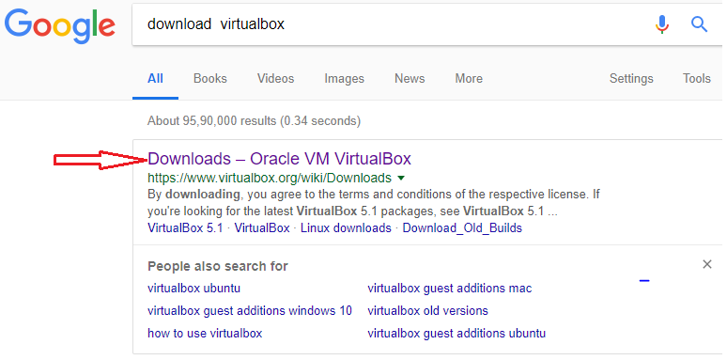
Downloading Oracle VM Virtual Box

Slide 6
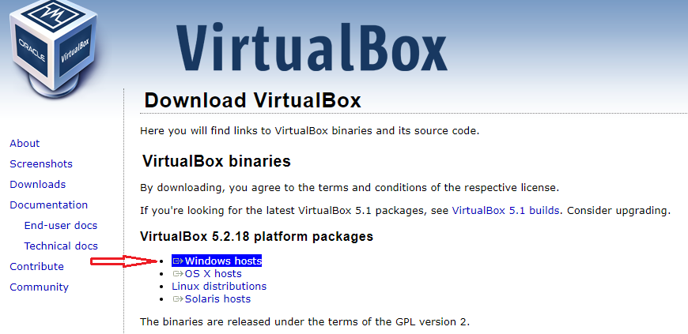
Downloading Virtual Box

Slide 7
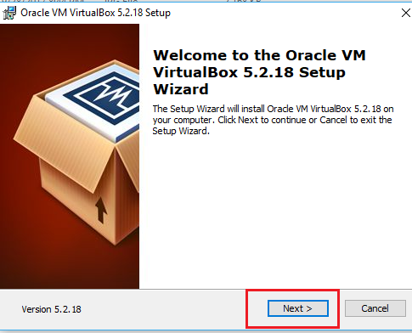
Installing Virtual Box

Slide 8
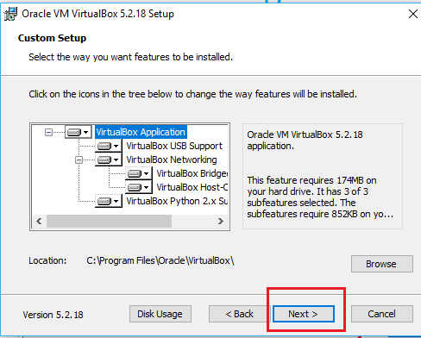
Installing Virtual Box

Slide 9
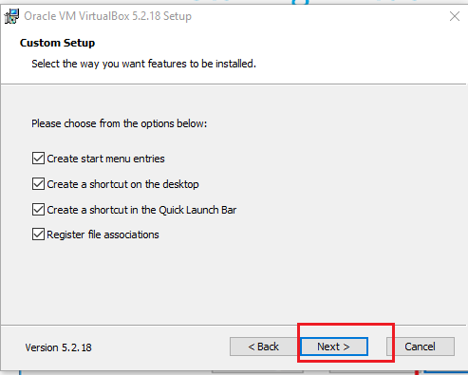
Installing Virtual Box

Slide 10
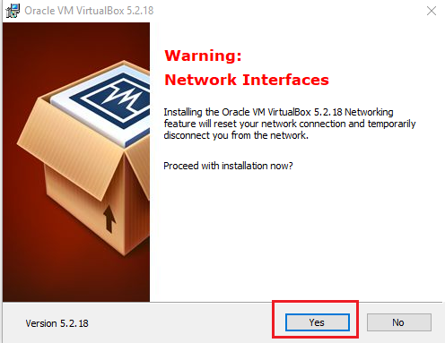
Installing Virtual Box

Slide 11
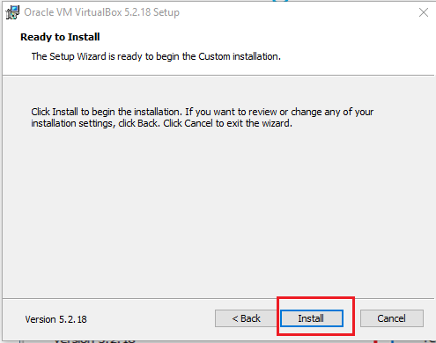
Installing Virtual Box

Slide 12
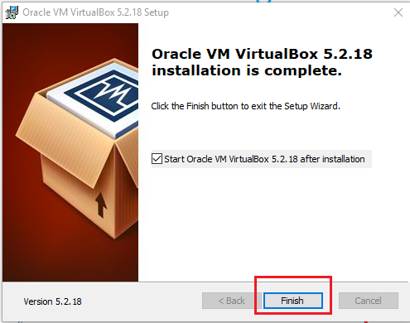
Installing Virtual Box

Slide 13
Setting Up Hadoop Environment
Virtualization software → Virtual Box → DONE
Virtual Machine → Cloudera Quick start VM → NEXT
Linux Emulator → MTpuTTY
File Editor → Notepad++
Secure File Transfer Tool → WinSCP

Slide 14
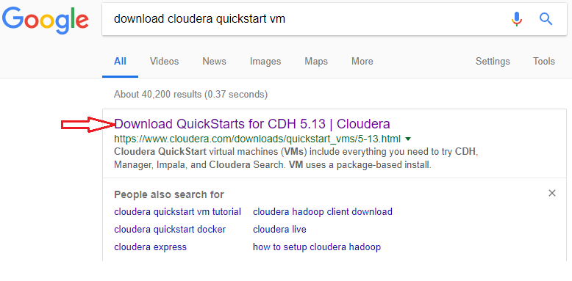
Downloading cloud era quick start VM

Slide 15
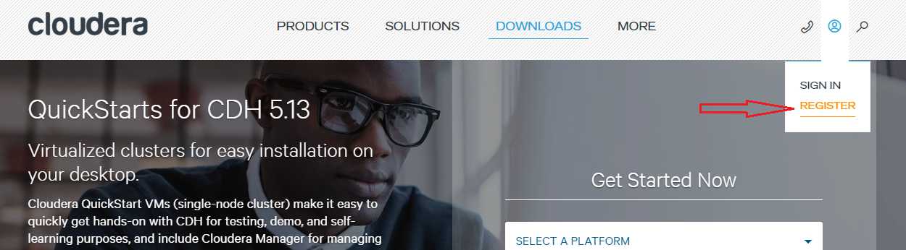
Registering with Cloudera

Slide 16
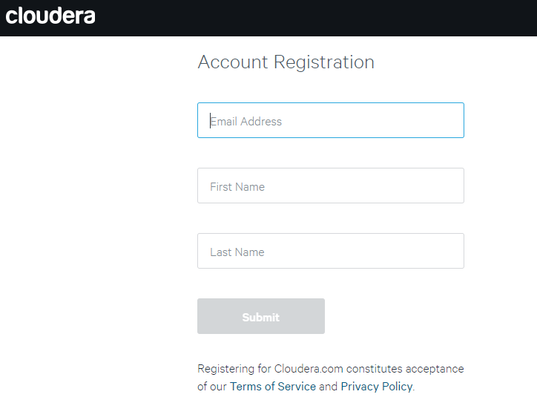
Registering with Cloudera

Slide 17
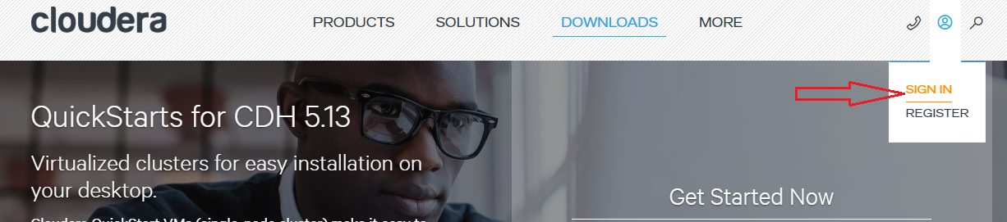
Sign to Cloud era

Slide 18
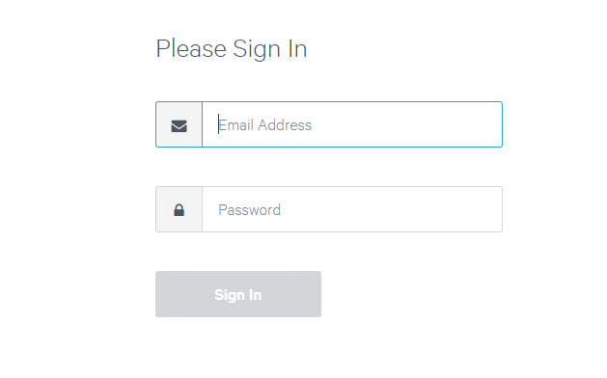
Sign to Cloud era

Slide 19
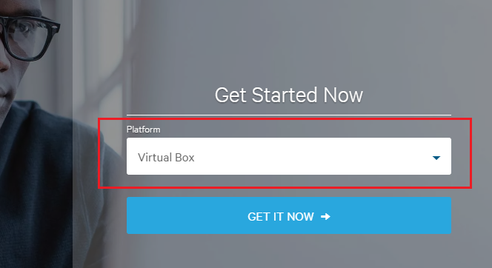
Downloading Cloudera Quick start VM

Slide 20
Downloading Cloudera Quick start VM

Slide 21
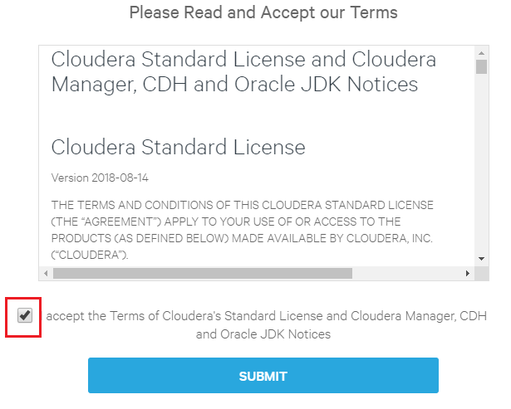
Downloading Cloudera Quick start VM

Slide 22
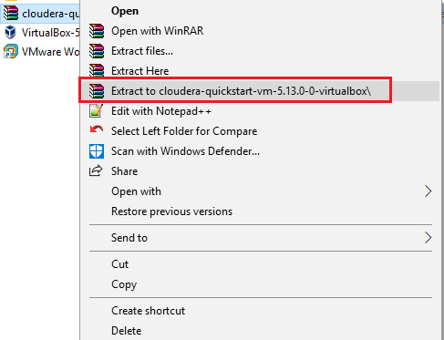
Extracting Cloudera Quick start VM

Slide 23
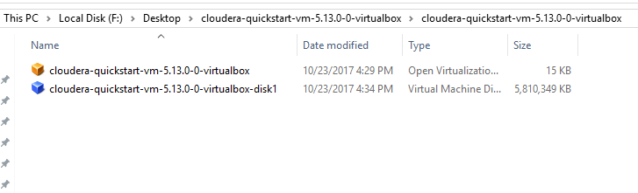
Extracting Cloudera Quick start VM

Slide 24
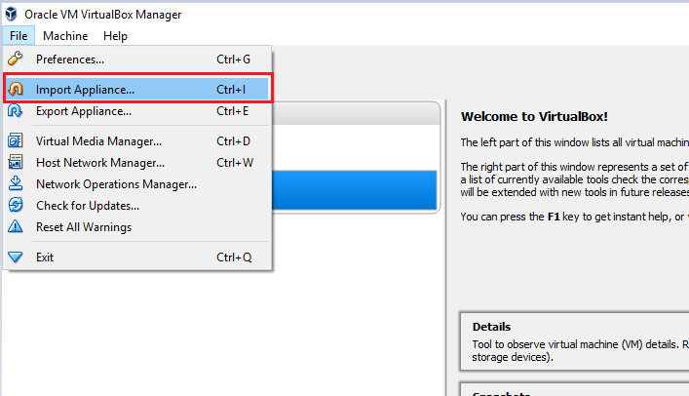
Importing Cloudera Quick start VM

Slide 25
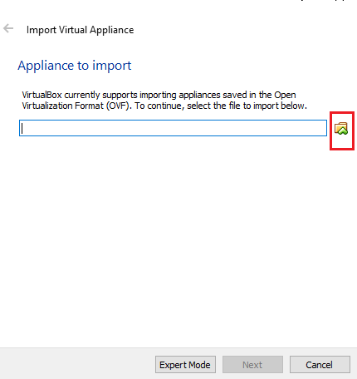
Importing Cloudera Quick start VM

Slide 26
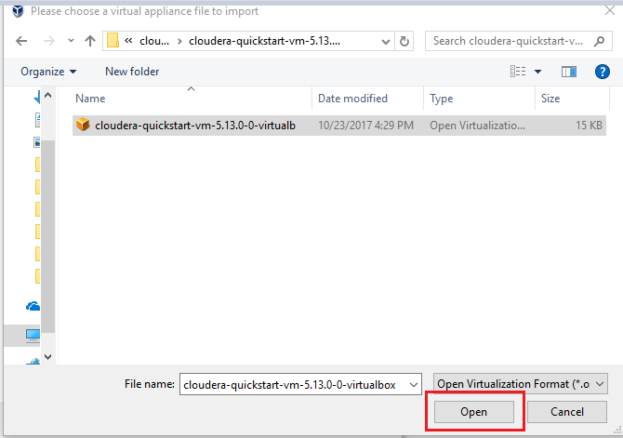
Importing Cloudera Quick start VM

Slide 27
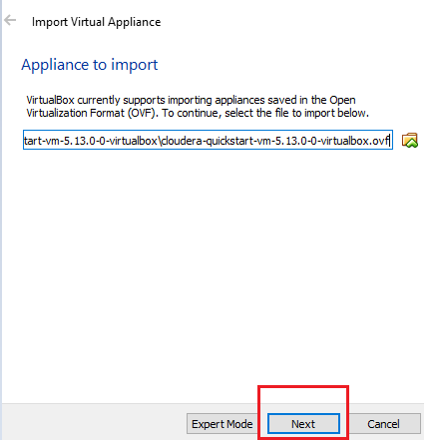
Importing Cloudera Quick start VM

Slide 28
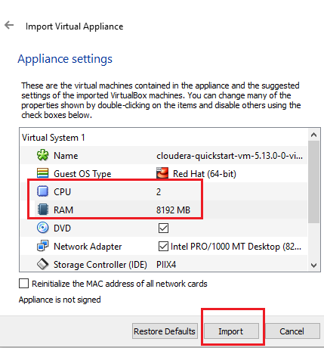
Importing Cloudera Quick start VM

Slide 29
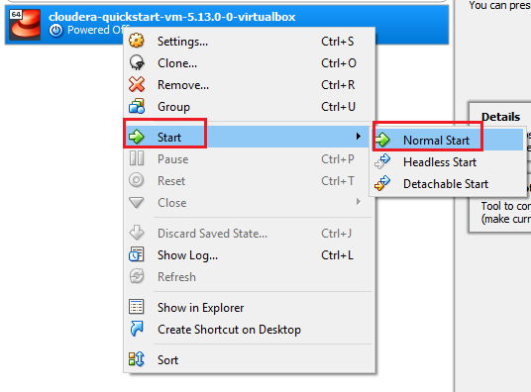
Starting Cloudera Quick start VM

Slide 30
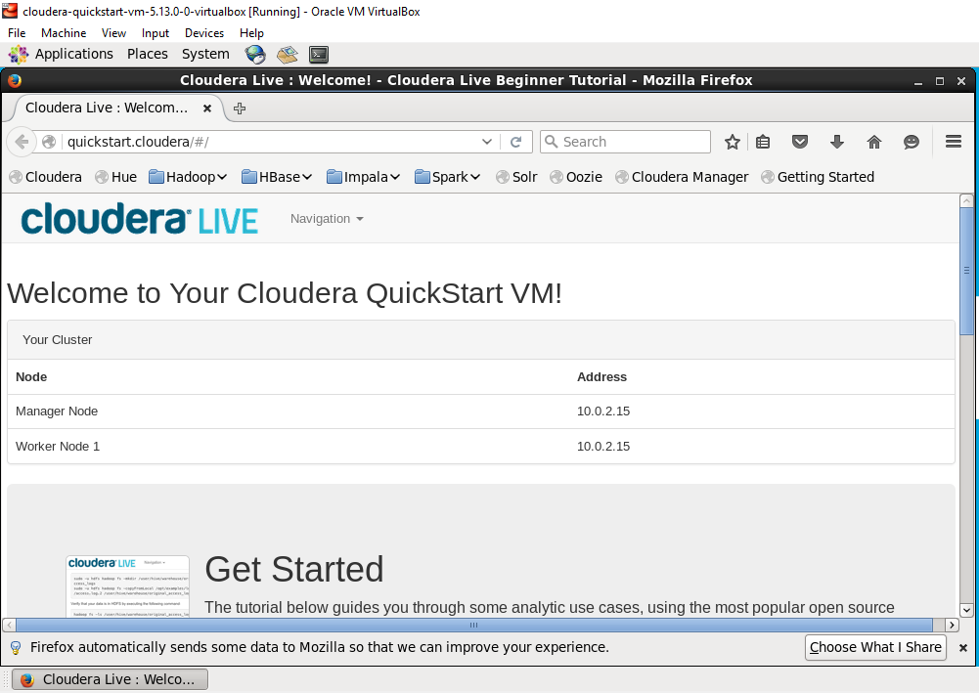
Welcome Screen of Cloudera Quick start VM

Slide 31
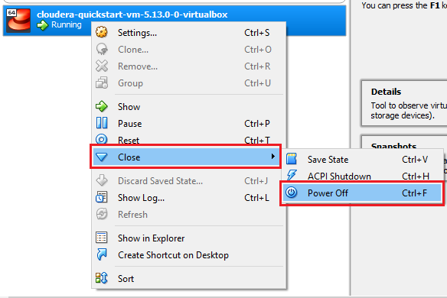
Power Off Cloudera Quick start VM

Slide 32
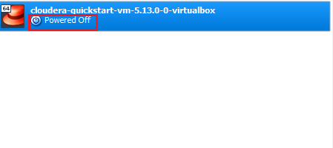
Power Off Cloudera Quick start VM

Slide 33
Setting Up Hadoop Environment
Virtualization software → Virtual Box → DONE
Virtual Machine → Cloudera Quick start VM → DONE
Linux Emulator → MTpuTTY →NEXT
File Editor → Notepad++
Secure File Transfer Tool → WinSCP

Slide 34
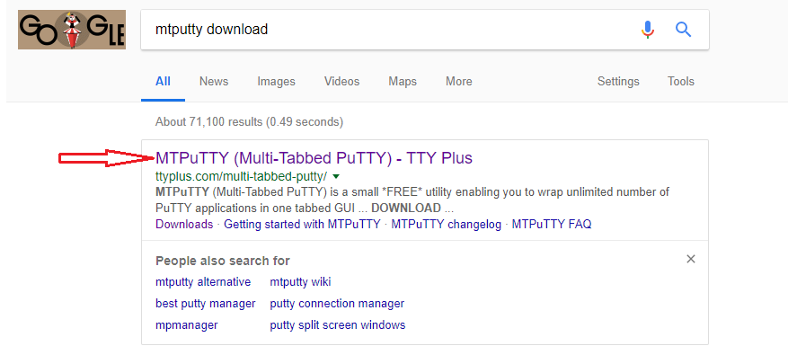
Downloading MTpuTTY

Slide 35
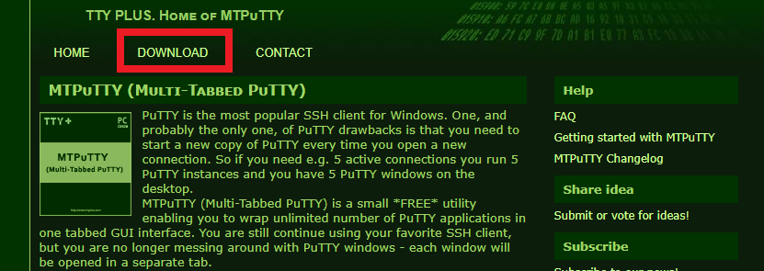
Downloading MTpuTTY

Slide 36
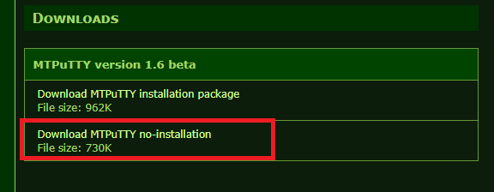
Downloading MTpuTTY

Slide 37
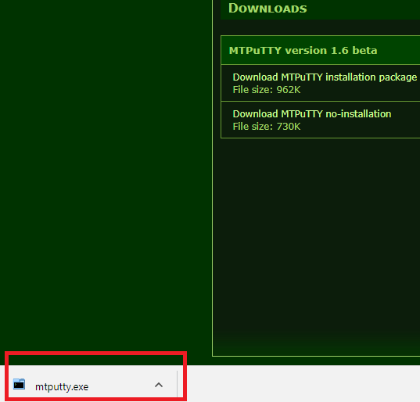
Downloading MTpuTTY

Slide 38
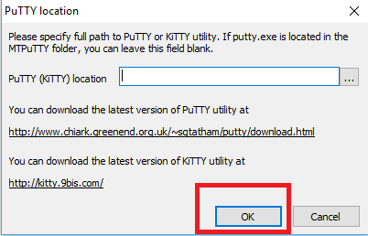
Downloading MTpuTTY

Slide 39
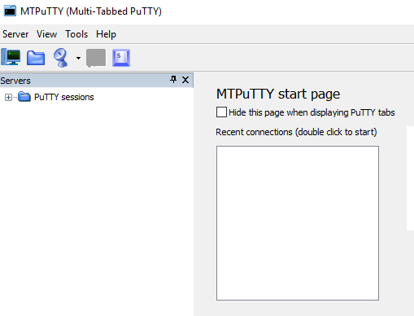
Initial screen of MTpuTTY

Slide 40
Setting Up Hadoop Environment
Virtualization software → Virtual Box → DONE
Virtual Machine → Cloudera Quick start VM → DONE
Linux Emulator → MTpuTTY →DONE
File Editor → Notepad++ →NEXT
Secure File Transfer Tool → WinSCP

Slide 41
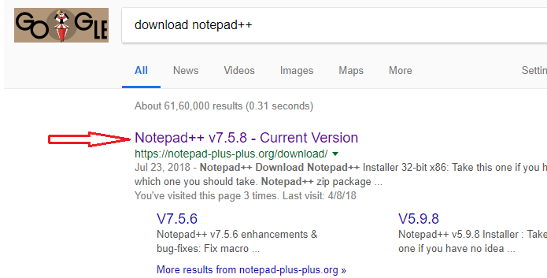
Downloading Notepad++

Slide 42
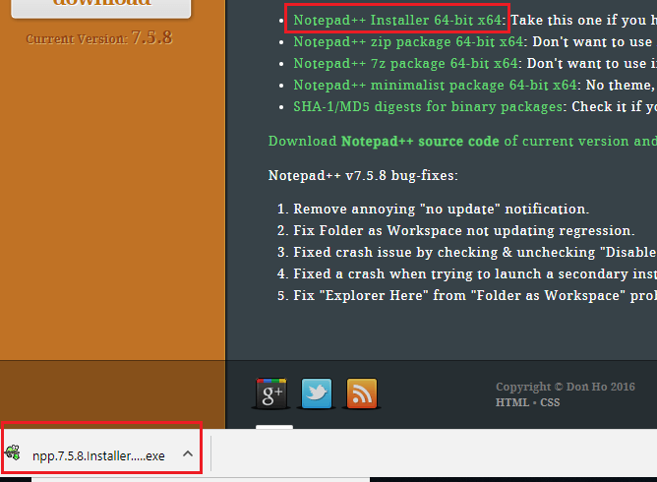
Downloading notepad++

Slide 43
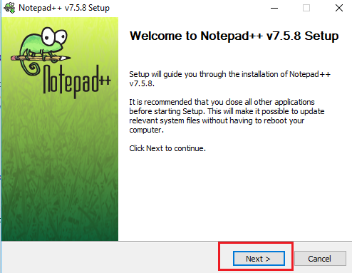
Installing Notepad++

Slide 44
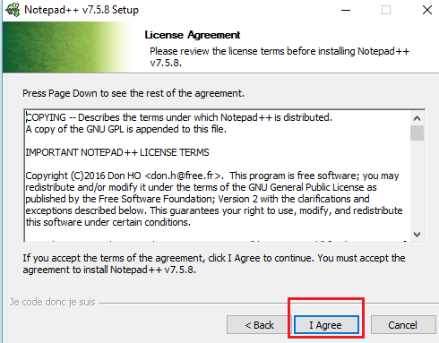
Installing notepad++

Slide 45
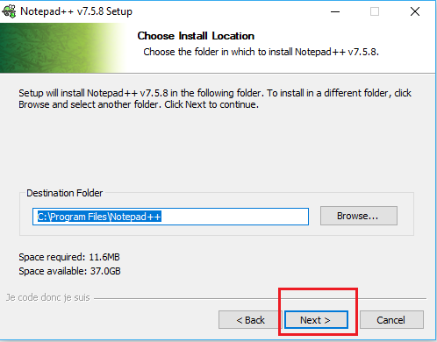
Installing Notepad++

Slide 46
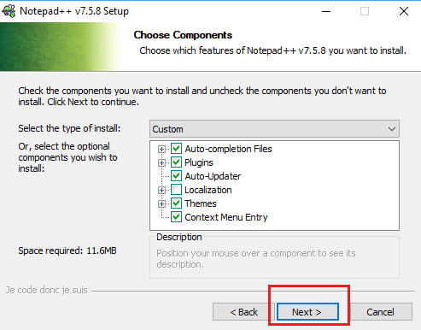
Installing Notepad++

Slide 47
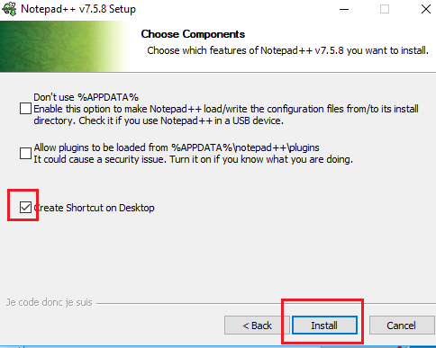
Installing Notepad++

Slide 48
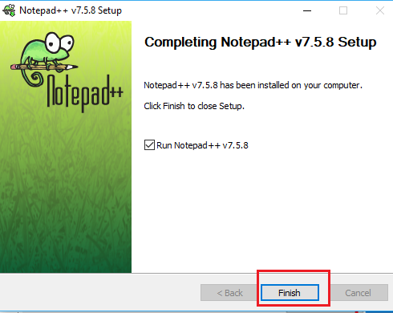
Installing Notepad++

Slide 49
Setting Up Hadoop Environment
Virtualization software → Virtual Box → DONE
Virtual Machine → Cloudera Quick start VM → DONE
Linux Emulator → MTpuTTY →DONE
File Editor → Notepad++ →DONE
Secure File Transfer Tool → WinSCP →NEXT

Slide 50
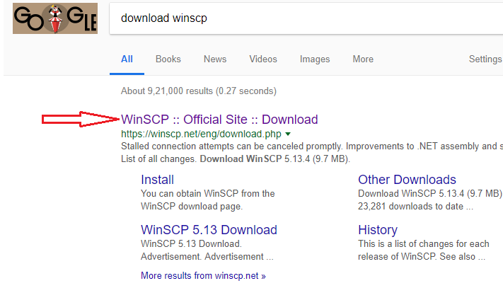
Downloading WinSCP

Slide 51
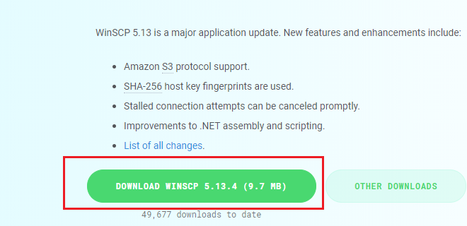
Downloading WinSCP

Slide 52
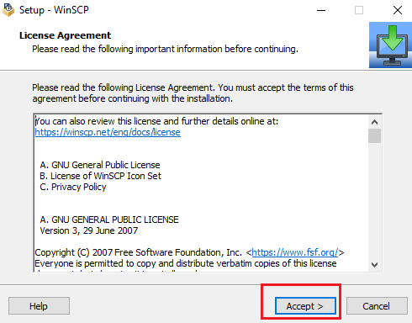
Installing WinSCP

Slide 53
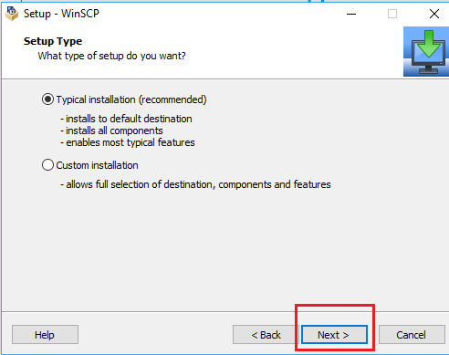
Installing WinSCP

Slide 54
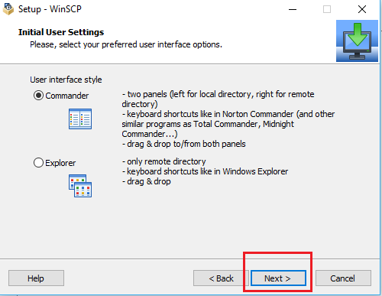
Installing WinSCP

Slide 55
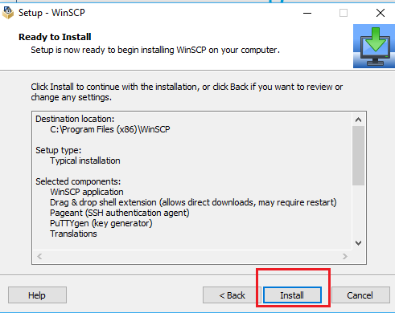
Installing WinSCP

Slide 56
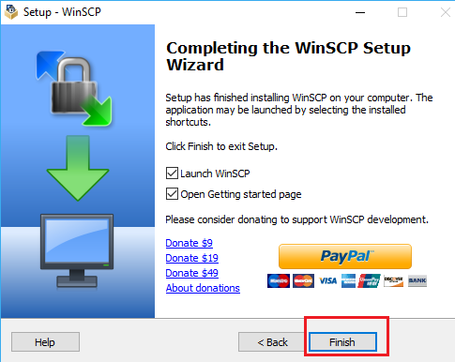
Installing WinSCP

Slide 57
Setting Up Hadoop Environment
Virtualization software → Virtual Box → DONE
Virtual Machine → Cloudera Quick start VM → DONE
Linux Emulator → MTpuTTY →DONE
File Editor → Notepad++ →DONE
Secure File Transfer Tool → WinSCP →DONE

Slide 58
Assignment for day-1
Download and install all the software that are needed for Hadoop environment
Hint: Refer this PPT ;-)

Slide 59
Any questions ?

Slide 60
Thank You!!!

